Slide 1
CO3 – AT3
TREE TRAVERSAL CHALLENGE
Preorder • Inorder • Postorder • Level-order
Done By :
Sk. Ashwaq Ahamed

Slide 2
1. Introduction to Tree Traversal
Tree traversal is the process of visiting every node of a tree in a specific order.
Depth-first traversals: Preorder, Inorder and Postorder.
Breadth-first traversal: Level-order.
The same tree can produce different sequences depending on the traversal method.
Goal: identify the correct traversal sequence from a given tree.

Slide 3
2. Traversal Rules
Preorder: Root → Left → Right
Inorder: Left → Root → Right
Postorder: Left → Right → Root
Level-order: Visit nodes level by level from top to bottom, left to right.
Use these rules to solve each challenge.

Slide 4
3. Challenge 1 – Inorder
Find the Inorder traversal of the tree.
50
Question: Write the node sequence using: Left → Root → Right
30
70
20
40
60
80

Slide 5
4. Challenge 2 – Preorder
Find the Preorder traversal of the same tree.
50
Question: Write the node sequence using: Root → Left → Right
30
70
20
40
60
80

Slide 6
5. Challenge 3 – Postorder
Find the Postorder traversal of the same tree.
50
Question: Write the node sequence using: Left → Right → Root
30
70
20
40
60
80

Slide 7
6. Challenge 4 – Level-order
Find the Level-order traversal of the same tree.
50
Question: Visit each level from top to bottom, left to right.
30
70
20
40
60
80

Slide 8
7. Challenge 5 – Medium Tree
Find the Inorder traversal.
40
20
60
10
50
80
15
70
Answer on next slide →

Slide 9
8. Challenge 6 – Medium Tree
Find the Preorder traversal.
40
20
60
10
50
80
15
70
Use Root → Left → Right

Slide 10
9. Challenge 7 – Medium Tree
Find the Postorder traversal.
40
20
60
10
50
80
15
70
Use Left → Right → Root

Slide 11
10. Challenge 8 – Difficult
Find ALL FOUR traversals of the tree.
55
30
75
20
45
65
90
40
50
70
1. Preorder
2. Inorder
3. Postorder
4. Level-order

Slide 12
11. Answers – Challenges 1 to 4
Challenge 1 – Inorder: 20 → 30 → 40 → 50 → 60 → 70 → 80
Challenge 2 – Preorder: 50 → 30 → 20 → 40 → 70 → 60 → 80
Challenge 3 – Postorder: 20 → 40 → 30 → 60 → 80 → 70 → 50
Challenge 4 – Level-order: 50 → 30 → 70 → 20 → 40 → 60 → 80

Slide 13
12. Answers – Challenges 5 to 7
Challenge 5 – Inorder: 10 → 15 → 20 → 40 → 50 → 60 → 70 → 80
Challenge 6 – Preorder: 40 → 20 → 10 → 15 → 60 → 50 → 80 → 70
Challenge 7 – Postorder: 15 → 10 → 20 → 50 → 70 → 80 → 60 → 40

Slide 14
13. Answer – Challenge 8
Preorder: 55 → 30 → 20 → 45 → 40 → 50 → 75 → 65 → 70 → 90
Inorder: 20 → 30 → 40 → 45 → 50 → 55 → 65 → 70 → 75 → 90
Postorder: 20 → 40 → 50 → 45 → 30 → 70 → 65 → 90 → 75 → 55
Level-order: 55 → 30 → 75 → 20 → 45 → 65 → 90 → 40 → 50 → 70

Slide 15
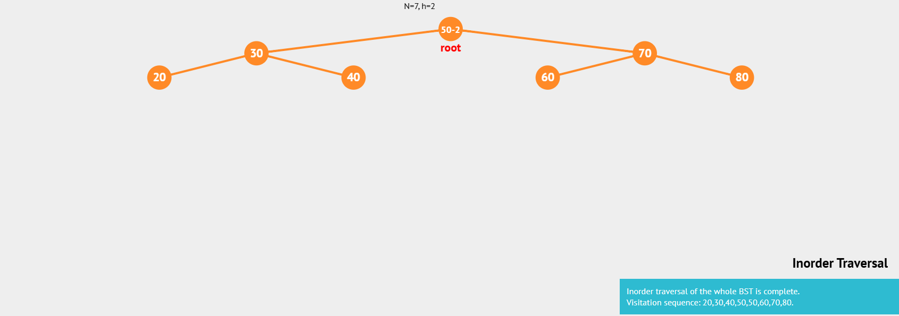
14. Verification Using a Tree Visualization Tool
Use a tree visualization tool to enter the same node structure.
Run each traversal and compare the generated sequence with the answers.
Capture screenshots of the tree and traversal output as evidence.
Recommended evidence: one screenshot for the easy tree, one for the medium tree, and one for the difficult tree.

Slide 16
15. Conclusion
Tree traversal determines the order in which nodes are visited.
Preorder, Inorder, Postorder and Level-order follow different rules.
The challenges provide practice in identifying traversal sequences.
Visualization tools can be used to verify the answers.
Tree traversal is an important foundation for understanding data structures and algorithms.

